Slide 1

Saving One Life: the best way to adopt
By: GCU Information x Technology Club
(Crystal Wake, Dominic Sutton, Ryne Darling, Nathan Ford and Cyrus Duncan)

Slide 2
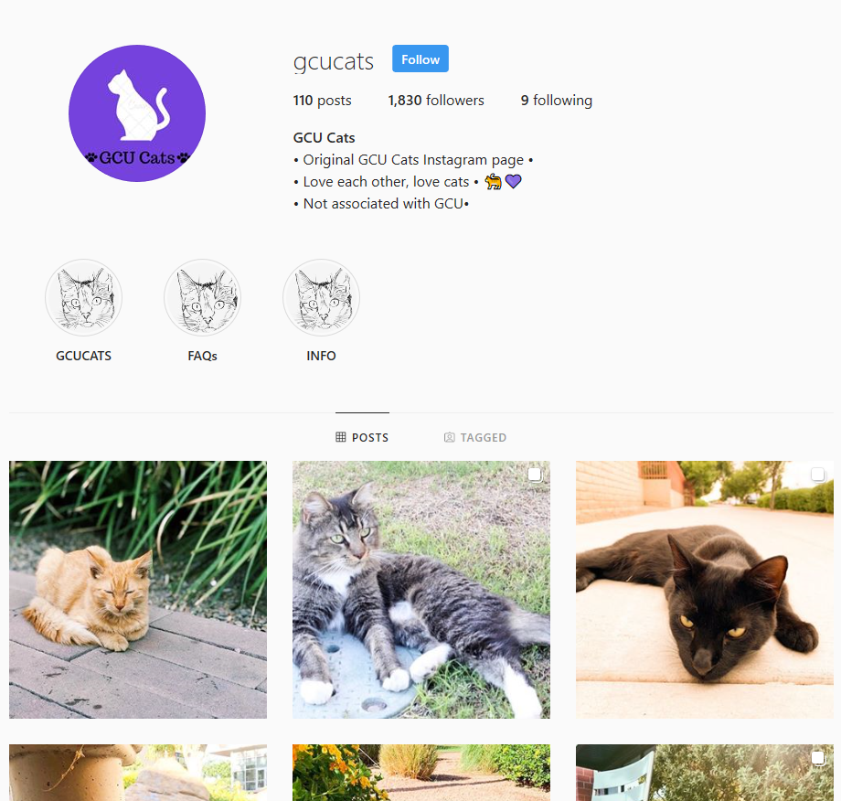

Our Team
GCU IxT is an IT club who strives to give back to their community.
Helping with Tech Support and Projects.
Credit to: https://www.instagram.com/gcucats/

Slide 3
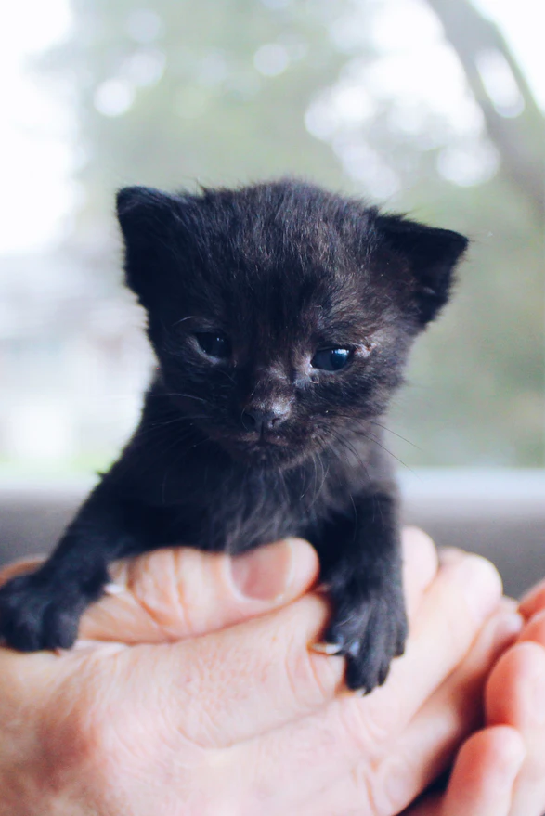
Purpose
GCU’s Purpose:
Helps the community by providing community service.
Saving One Life’s Purpose:
Non-profit focused on saving animals who would otherwise perish.

Slide 4
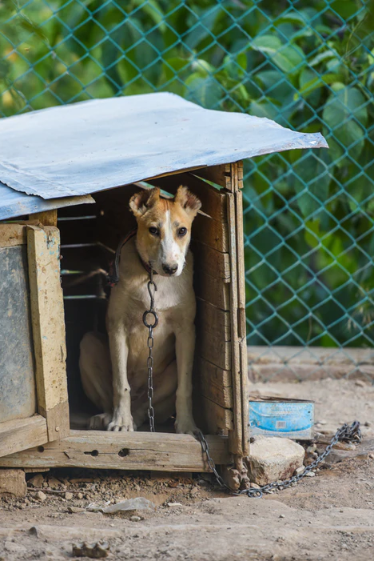
Call to Action
Giving back to the community
Our tie with the animals on campus
Saving animals lives
Giving resources to an NPO

Slide 5
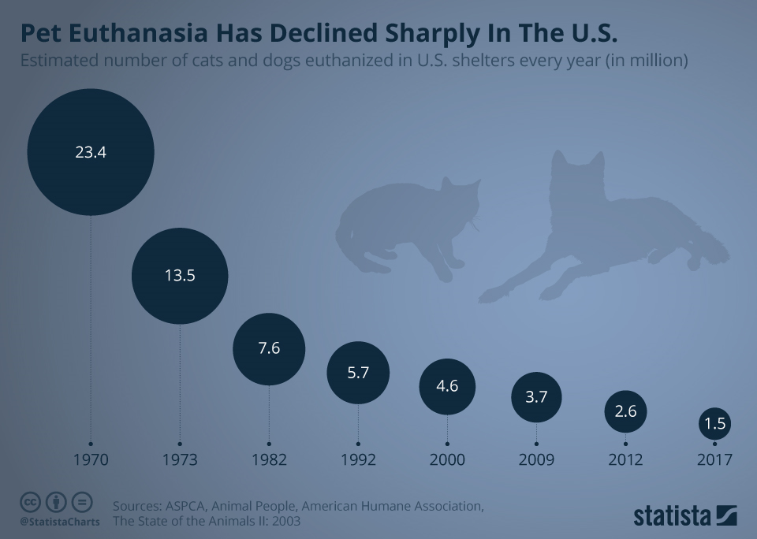
The Problem
Lack of updated tech
WordPress failure issues
Unreliable Database
Hard to read data tables
No data transfer system
Longer application times
Pets don’t get adopted
Scale: Global Issue
Complexity of Issue:
API’s to work
Formatting JSON
Saving Locally
Returning to form

Slide 6

Our Solution
Create an easier application
Separate JSON file from fields and data
Access the applicant’s forums faster
Perform faster background checks
Transfers data to platforms with no issues
Works with any file and database
Easy to use system
Will work on all devices

Slide 7
Our Process
Create a design
Code
Code V.1
Create
Design
Fix UI issues
Fix Syntax Errors
Finish Design
Finish Code
Create a forms
Read File
Print
Notes:
Talk as a group and create a rough sketch of the application.
Use Java Enterprise to code the application
Place all design, coding, security and all other features together. Test the application and fix syntax errors.

Slide 8
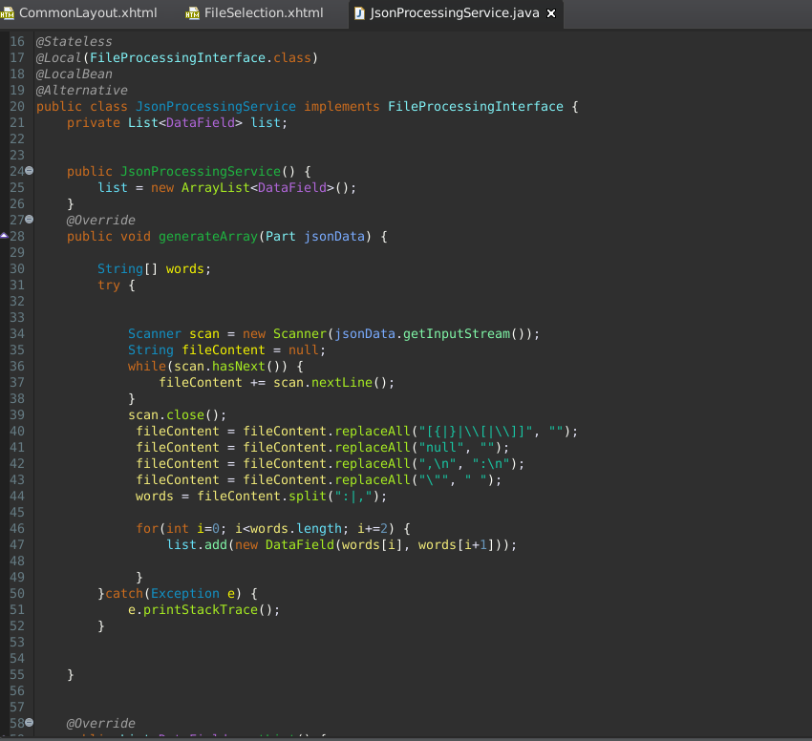
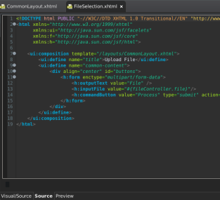
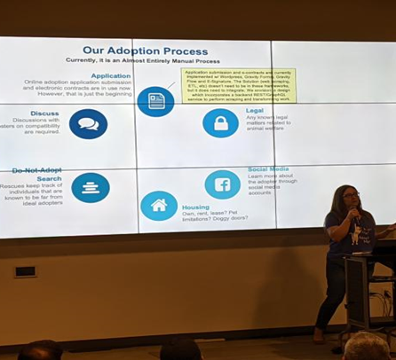
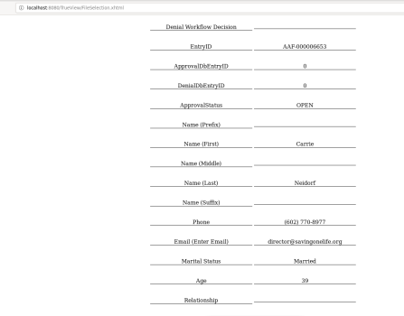
Starting process to code

Slide 9
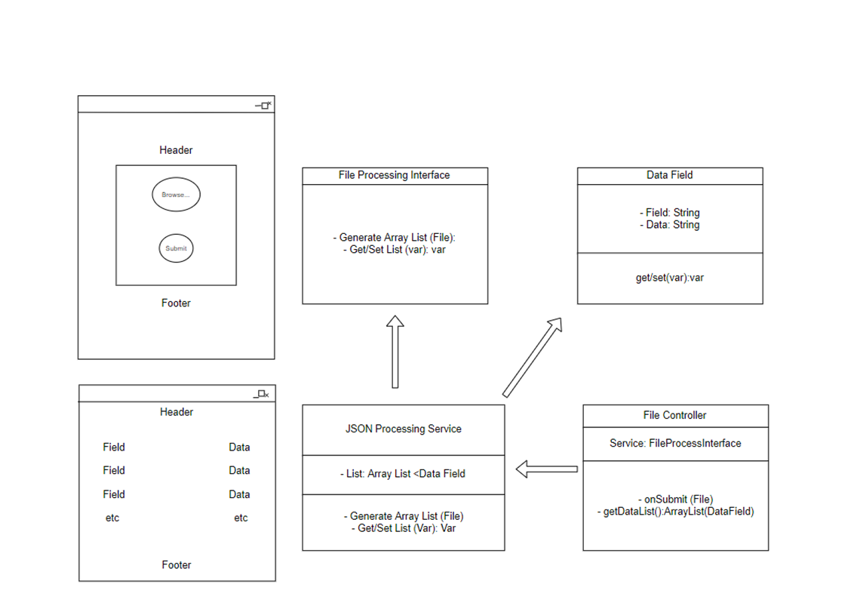
Implementation
Shows the admin side of the application
Will place on the existing site
Separates data and field
Alternative Solution – Use Angular to refile database
Backup: Java Enterprise

Slide 10
Our Progress
Beginning
Middle
End
Coded Java Enterprise
Made easy to implement
Added parts of the app
Finished testing
Final approval
Plan/Documentation
Layout
Started creating
Based off expectations
Added example images
Coded Java Enterprise
Made easy to implement
Added parts of the app

Slide 11


Future Upgrades
Using common storage files (CSV) the containers
Easily implemented into any database with no issues.
Security: No need since there is no saved data.
Locally saved. (JSON files)

Slide 12


Customer Experience
Creates a clear and easy layout
Understands the customers
Relates to the customers needs
Captures applicant feedback in real time
Quality framework for development
Acts on customer feedback
Delivering customer experience
Notes:
Creates a clear, easy and enjoyable layout for the customer.
Understands the customers needs/wants and reflects them in an easy to read format.
Relates to the customers needs and shows that the customer is first.
Captures applicant feedback in real time.
Quality framework for development.
Acts on customer feedback.
Delivering great customer experience.

Slide 13
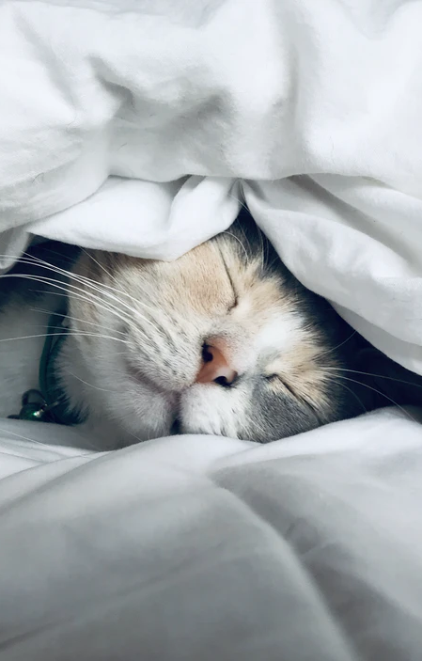
Impact
Creates faster adoptions
Helps animals get resources
Saves resources
Most accurate adopting system
Increasing the amount of animal’s lives.
Open Source to all NPO’s
Extreme productivity gain
Saves money on resources/production
Reducing application time
Notes:
The need to save lives is significant, especially in Phoenix. However, technology adoption is quite slow.
I know first-hand how modern technologies could revolutionize all rescues, not just those in Arizona.
Saves resources that could be used towards finding the right match vs using extra resources to look through applicants.
Our system will make adopting to the right and safest home as fast as possible.
Increasing the amount of animal’s lives.

Slide 14

Conclusion
Work remaining:
More style
API’s added
AI added
Conclusion:
Fully functional
Versatile on all devices
Backup is universally added
Tested with no error or security flaws
Never been done before
This Photo by Unknown Author is licensed under CC BY-SA-NC

Slide 15
References
https://www.aspca.org/animal-homelessness/shelter-intake-and-surrender/pet-statistics
https://www.statista.com/chart/13493/pet-euthanasia-has-declined-sharply-in-the-us/
https://www.savingonelife.org/

Slide 16

Thank you!

